Slide 1


PASSWORD BASED
LOCK SYSTEM
19ECE304 Microcontrollers and Interfacing Techniques
Electronics and Communication Engineering
Semester V – 2020-24 Batch

Slide 2
CCE Team 9
Name | Roll Number
Arpit Chandel | CB.EN.U4ECE20107
Kallakuri Nikhitha | CB.EN.U4ECE20127
Kavinandhan B | CB.EN.U4ECE20130

Slide 3


INTRODUCTION
What is the main AIM of our project ?
The Project aims to build a Password based Lock open system.
LPC2148 MCU is used as the Microcontroller
Aims to make a secure and safe locking system.
Ex: A token based digital identity device.

Slide 4
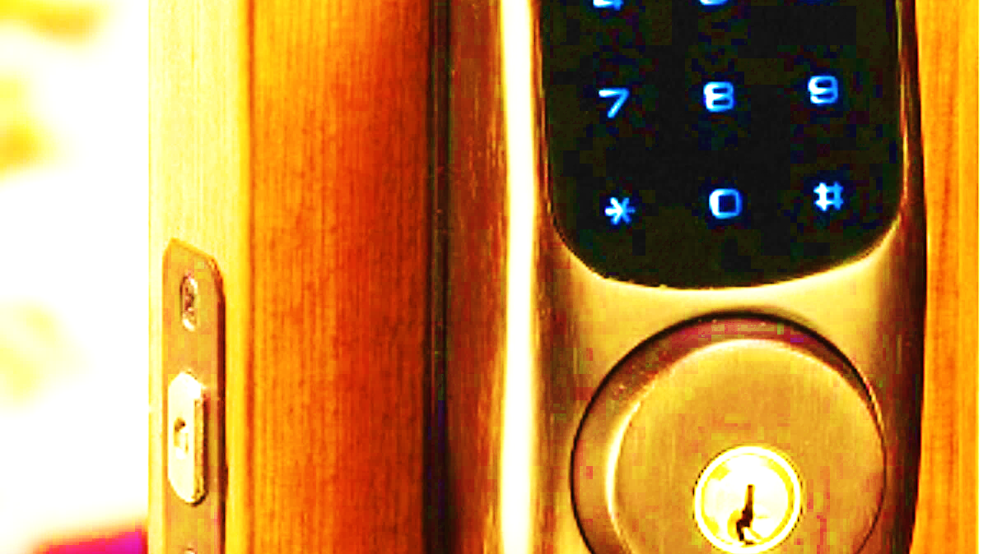
PROJECT DESCRIPTION
The system has various components which controls the output load through a Password.
ARM7(LPC2148) which provides control to the actuating the load, It is a simple embedded system with input from the keypad and the output being actuated accordingly.
If the Password entered is correct, The system unlocks, or else it terminates with a short error message.
This helps in many security preaching applications like Office Biometrics, Bank door lock.

Slide 5
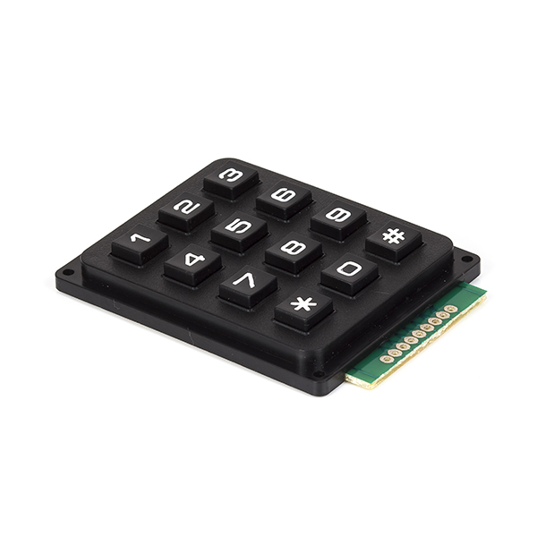
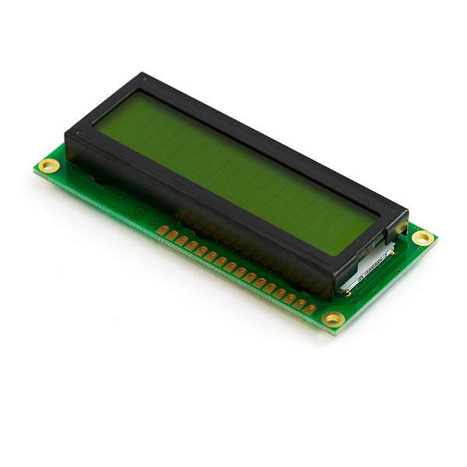

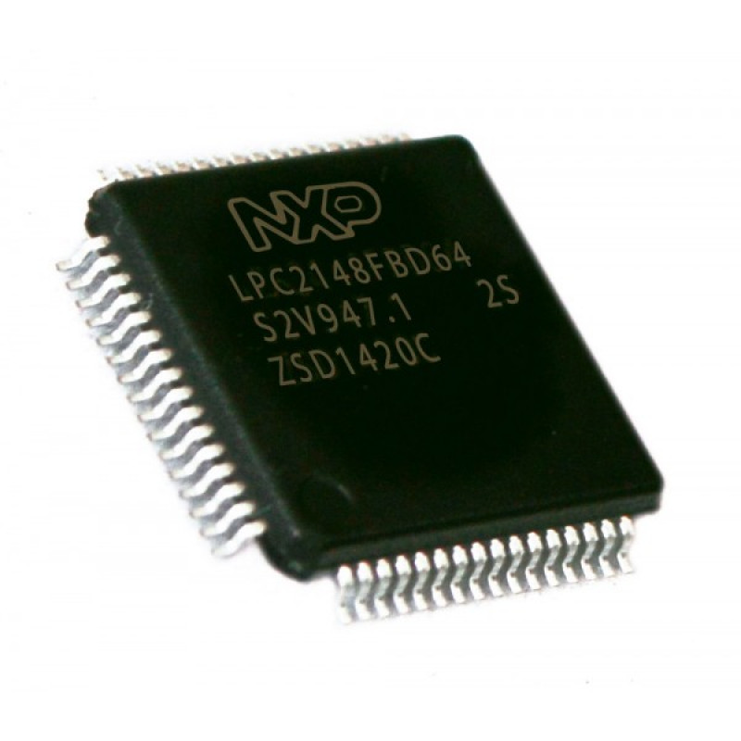

COMPONENTS REQUIRED
Hardware - LPC2148 Development Board, LCD Module – LM016L, 4*3 Keypad – Phone, DC Motor and L293D (Motor Driver)
Software - Keil µVision4 IDE and Proteus 7 Professional (Labcenter Electronics)

Slide 6
Algorithm – Main() Function
Load the DDRAM in the second line of the LCD to display the letters.
Pass the output of the keypad to be displayed in LCD.
Display the appropriate command and call the DC Motor functions for respective operations.
Clear the contents on LCD and set delay.

Slide 7
Algorithm – Keypad() Function
Configure the rows and columns to the P1.16 to P1.22 pins.
Keypad scanning is done, and the corresponding column and row will be returned, if any keypress this is detected in that corresponding column or row.
Call the lcd_int() function to display the key pressed on the LCD display.

Slide 8
Algorithm – LCD() Function
Configure P0.2 & P0.3 pins as output. Configure RW pin of LCD to ground.
To Enable 4-bit mode, configure (P0.4, P0.5, P0.6, P0.7) to the data lines D4, D5, D6 and D7 respectively & send the commands.
Set RS is low, for instruction register and EN is low, Set RS is high for data register.
Call the function lcd_int() to display the message on line 1 or line 2 of LCD.

Slide 9
Algorithm – Motor() Function
forward(), configure P0.16 & P0.18 as LOW. When key pressed Set P0.17 as HIGH to rotate the motor in the forward direction.
reverse(), configure P0.17 & P0.18 as LOW. When key pressed Set P0.16 as HIGH to rotate the motor in the reverse direction.
Clear all pins, to stop Motor rotation.

Slide 10
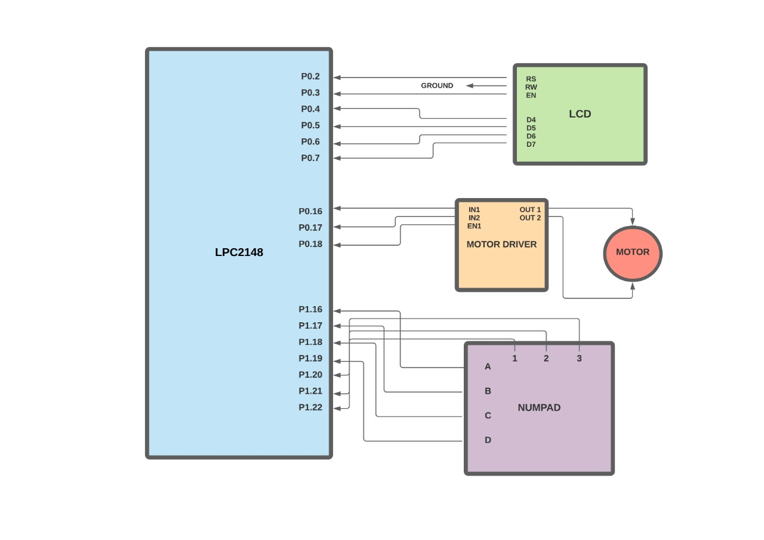
Circuit Diagram Representation

Slide 11
WORKING EXPLANATION
The project consists of blocks as a microcontroller, a keypad, an LCD, a DC motor, and a motor driver.
The keypad is an input device which helps to enter a password to open the door. It gives the entered code signals to the microcontroller. LCD is used to indicating devices for displaying the information.
It will ask for the Password. By default, password is “1234”. It will open the door and again will close if we enter the correct password. Otherwise, it won’t open the door at all.
The DC motor moves the door to open and close and the motor driver drives the motor after receiving the code signals from the microcontroller.

Slide 12
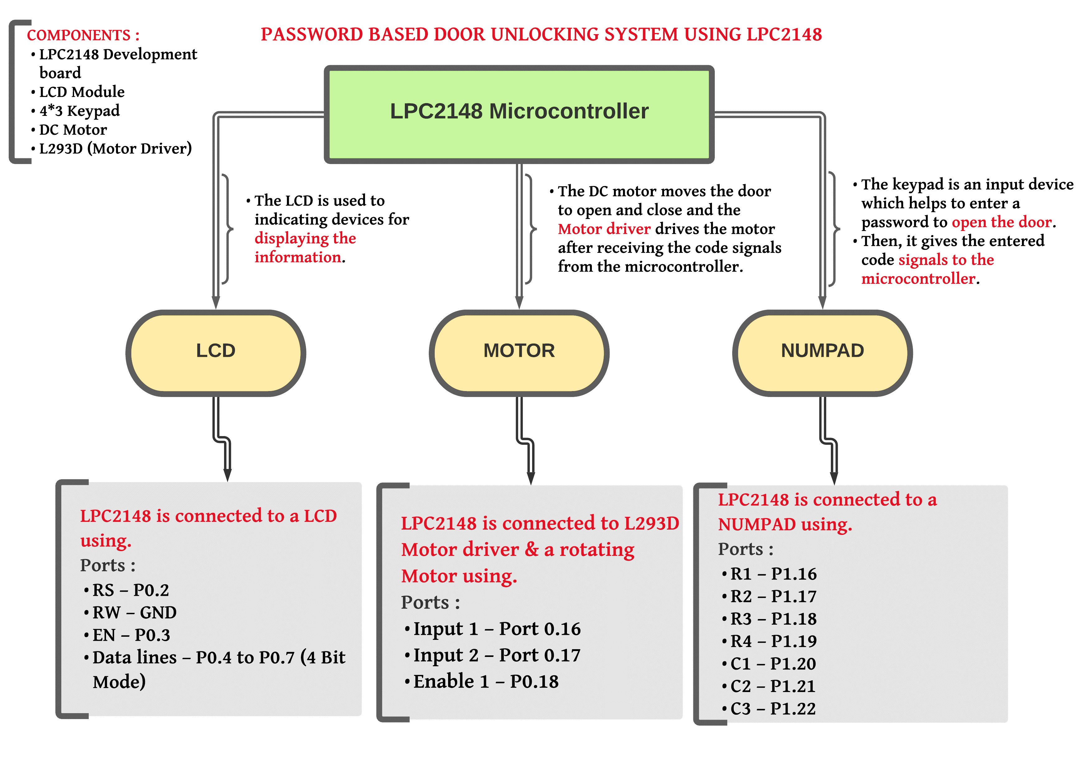
SUMMARY

Slide 13
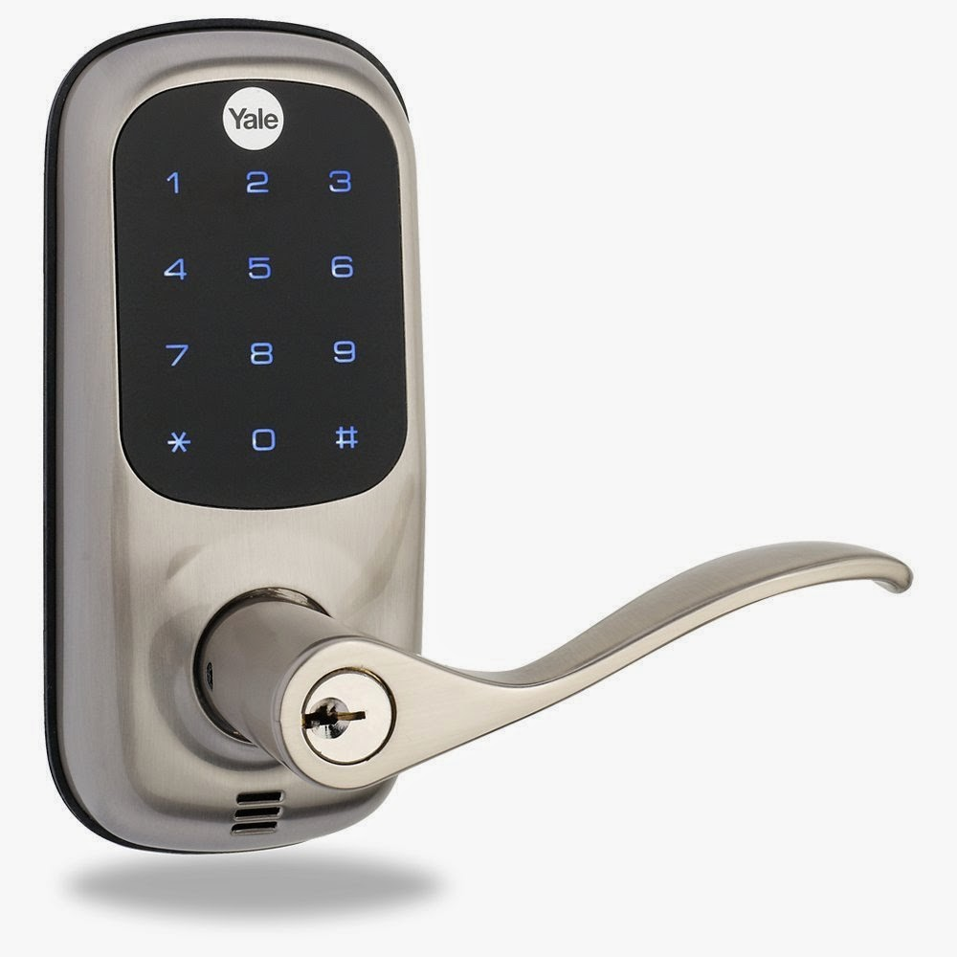
CONCLUSION AND FUTURE PROSPECTS
The security level can be increased by adding a biometric fingerprint scanner. We can interface sensors like Fire, LPG, PIR motion detectors to the microcontroller in case of an accident so that door will open automatically.
In future, this “Password-Based Door Open-Lock System” can be provided maximum security by the above enhancements to completely satisfy the user’s needs.

Slide 14

REFERENCES
Password Based Door Lock System, International Research Journal of Engineering and Technology (IRJET), e-ISSN: 2395-0056, Feb 2019 (www.irjet.net)
Embedded High Alert Door Locking System Using IoT Technology, International Journal of Computer Science and Engineering (IJCSE) Special Issue, May 2017 (https://www.internationaljournalssrg.org/uploads/specialissuepdf/ICACCE/2017/CSE/IJCSE-NCACCE-P104.pdf)
Onetime Password Based Door Lock System: https://hackprojects.wordpress.com/projects/arm-projects/password-and-onetime-password-based-door-lock-system/
Password Based Door Open System Using LPC2148: https://embetronicx.com/projects/lpc2148-projects/password-based-door-open-system-using-lpc2148/
YouTube LPC2148 Microcontroller Tutorials

